Slide 1
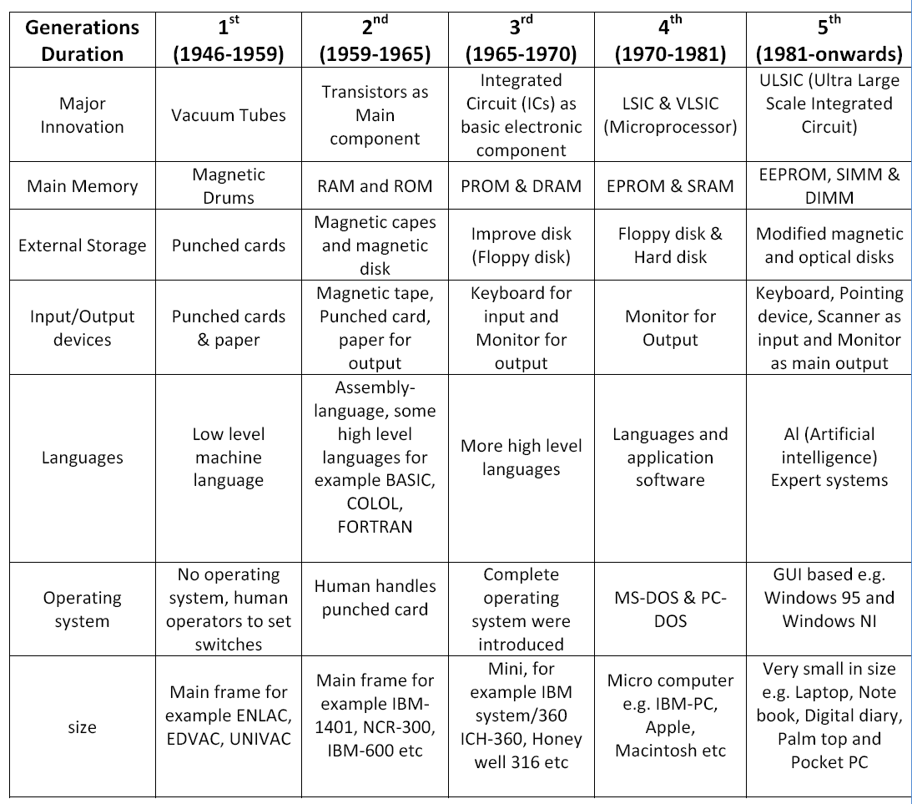

Slide 2
Decimal vs Binary

Slide 3
Understanding Performance
Algorithm
Determines number of operations executed
Programming language, compiler, architecture
Determine number of machine instructions executed per operation
Processor and memory system
Determine how fast instructions are executed
I/O system (including OS)
Determines how fast I/O operations are executed

Slide 4








Eight Great Ideas
Design for Moore’s Law
Use abstraction to simplify design
Make the common case fast
Performance via parallelism
Performance via pipelining
Performance via prediction
Hierarchy of memories
Dependability via redundancy

Slide 5
Computer Architecture and Organization
Architecture – What to do?
Organization – How to do?
Architecture – Connected to design
Organization – Building process or Implement
Example – Calculator

Slide 6
Architecture vs Organization
Architecture will always be concerned with what to do?
Organization will take care of how to do?
In simple terms, architecture is concerned with the design and organization is concerned with the building process.
Architecture shall carry out the analysis and zeroing in about the instructions, modes of addressing and usage of registers.
Computer Architecture carries the precedence than Computer organization.
Only after the design, the implementation can be done.
It is to be compared with high level design.
For example, if a calculator is built, it is to be decided if it will support the division operation is an architectural analysis. Likewise, all the features which a computer has are defined at architectural phase.

Slide 7
Contd.,
Organization is the next phase to architecture.
Or, organization is dependent on architectural decisions.
Realization of the architectural decisions happens through the organization.
The same example of Division operation is now to be seen from the organization perspective.
Having decided to support Division operation, organization shall enable to have the division done through the repeated subtraction or through division unit.
This decision of if to go with repeated subtraction or otherwise is the role of Organization.
Organization shall also help in identifying or uncovering design issues or challenges.

Slide 8
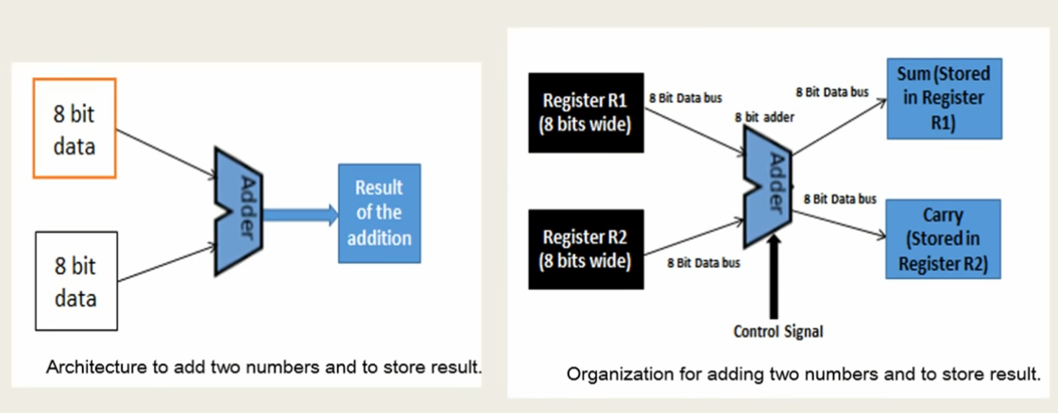

Slide 9
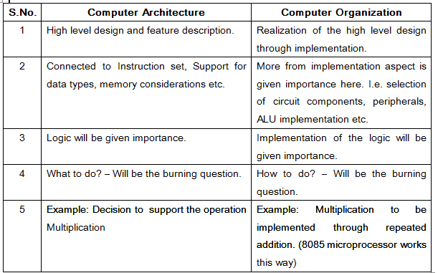

Slide 10
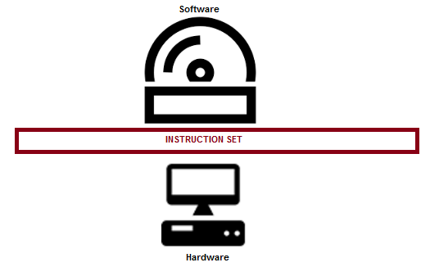
ISA – Instruction Set Architecture
Instruction Set Architecture, ISA, is an interface between the hardware and software and it is indeed playing the role of an instructor to instruct the hardware about what to be done through the software instructions.
In other words, ISA helps to utilize the hardware to its complete ability through the software instructions.
It is a mediator and acts as a frontier amid the software and hardware.

Slide 11
Contd.,
ISA helps in defining the operations, modes of operation supported, addressing, storage related inputs, how to use, perhaps, how to access the operands through instructions etc.
In short, or more precisely, one could say that, a processor is detailed through the instruction set architecture.
There are many processors and there could be many ISAs.
The ISA would support multiple instructions and instruction types based on the processor selected.
The instructions specified by the ISA shall be well interpreted by the processor and corresponding action shall be initiated. ISA is a collection of instructions and formats supported for the processor. Through ISA, i.e. instructions one can access the resources.

Slide 12
Contd.,
Now, it is ISA’s role in deciding the following very important considerations.
What is the operation to be performed?
Where to store the operands?
Where to store the result of the operation?
How many operands are needed to perform (this) operation?
Does the ISA support the operation specified? (For an instance 8085 does not support multiplication and division).
What is the type of the operation? (it can be classified, reader shall be introduced to this)
What is the format of the operation?
Size of the operands.
What are the addressing modes supported? How to address the operands?

Slide 13
Contd.,
A = B + C (ADD A, B, C)
Where,
A has the result of the operation
B and C are the operands which are to be added. (B and C are called registers, which has values inside)
“+” is the operation, i.e. addition.
“=” is the assignment operation, after the expression is evaluated, the result shall be assigned to A.
The same addition expression mentioned above shall be accomplished through the instruction ADD A, B, C where B and C are the source registers with A being the destination register.

Slide 14
The 3 most common types of ISAs are(based on number of operands)
Stack - The operands are implicitly on top of the stack.
Accumulator - One operand is implicitly the accumulator.
3. General Purpose Register (GPR) - All operands are explicitly mentioned; they are either registers or memory locations.

Slide 15
Identify the idea
To go from a complex application to the simple instructions involves several layers of software that interpret or translate high-level operations into simple computer instructions
Hardware Software interface
Notes:
First –Abstraction,2nd ISA

Slide 16
Architecture or Organization
Instruction Set
Control signals
Instruction Size
Addressing Modes
Notes:
Inst Set-Architecture,Control signal-Organization, IS-Architecture ,AM-Architecture

Slide 17
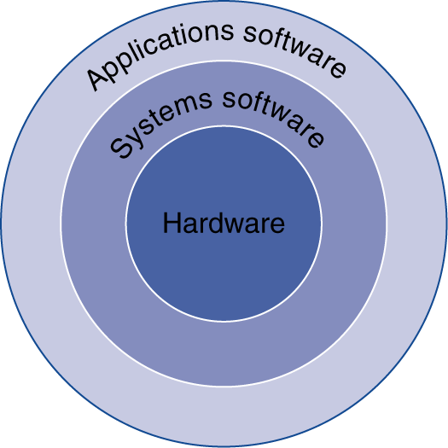
Below Your Program
Application software
Written in high-level language
System software
Compiler: translates HLL code to machine code
Operating System: service code
Handling input/output
Managing memory and storage
Scheduling tasks & sharing resources
Hardware
Processor, memory, I/O controllers

Slide 18
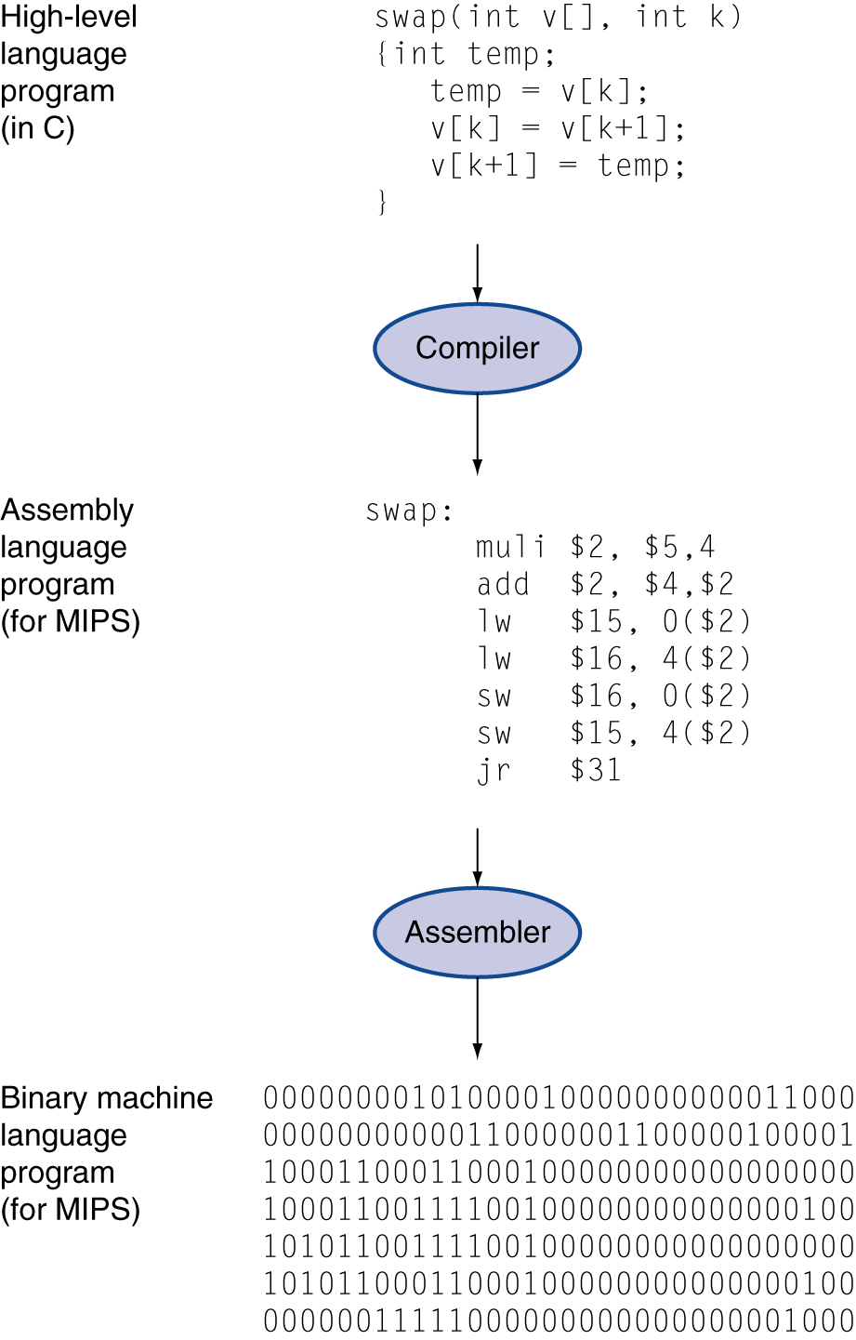
Levels of Program Code
High-level language
Level of abstraction closer to problem domain
Provides for productivity and portability
Assembly language
Textual representation of instructions
Hardware representation
Binary digits (bits)
Encoded instructions and data

Slide 19
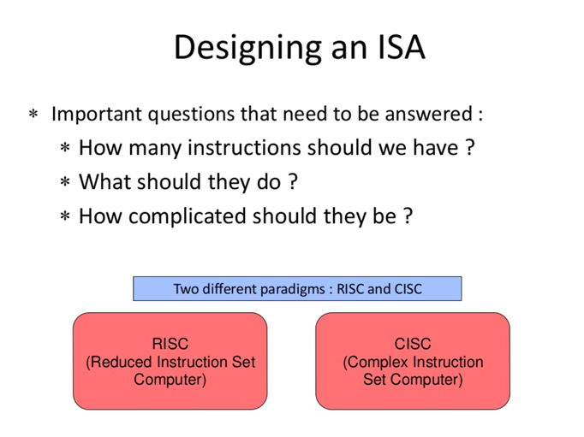

Slide 20
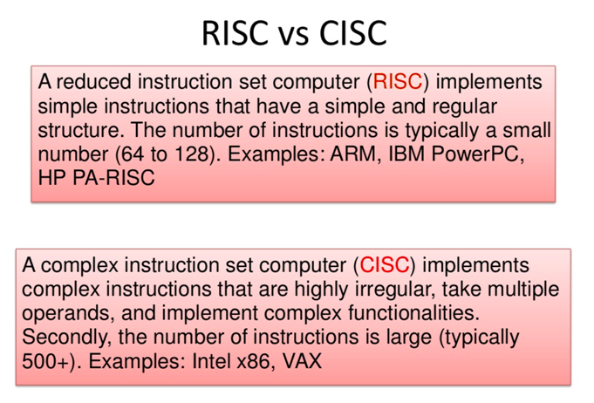

Slide 21
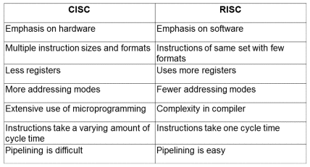
CISC and RISC

Slide 23
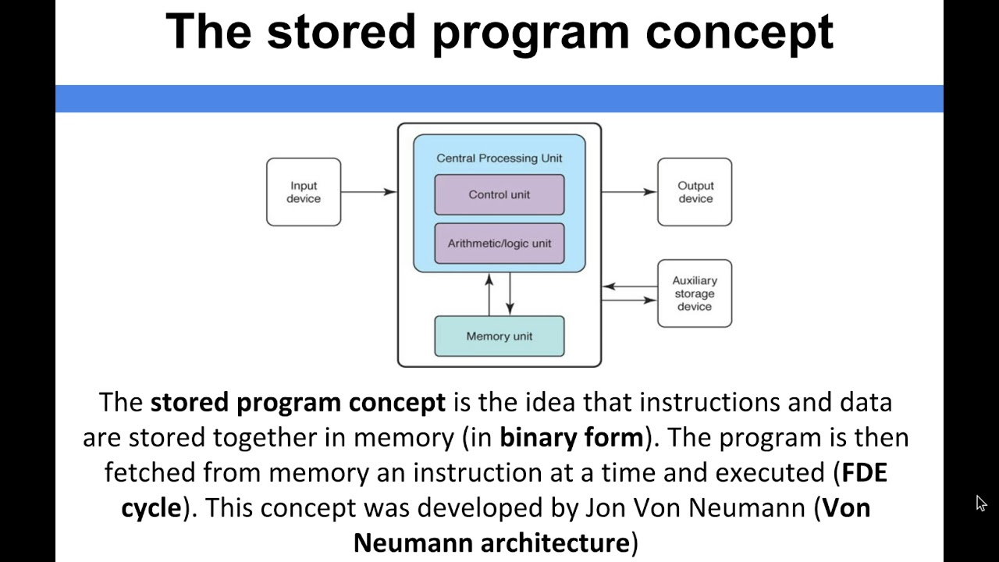

Slide 24
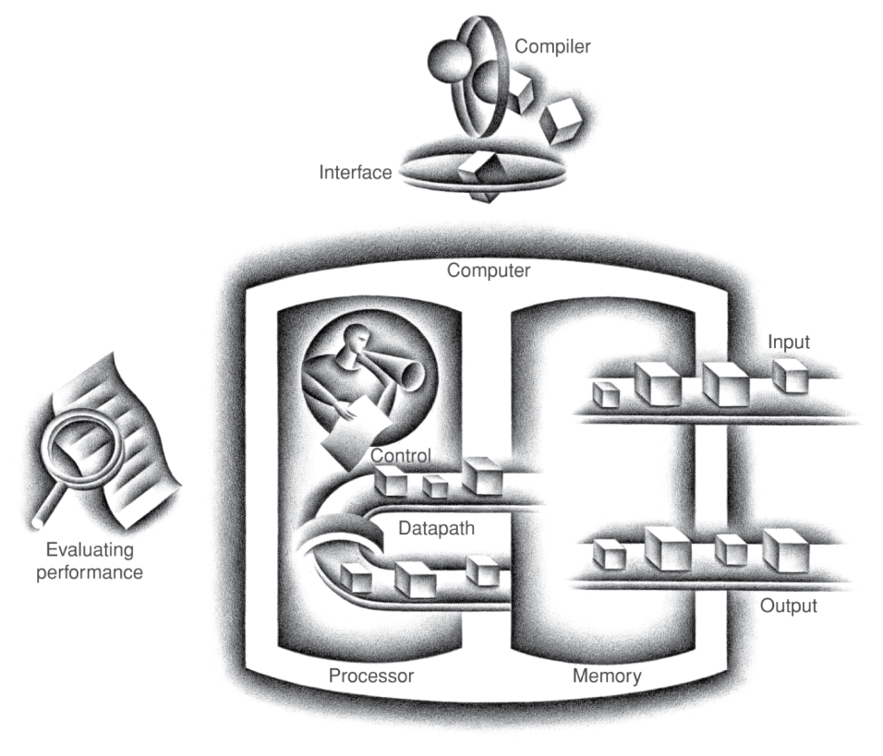
Components of a Computer
The BIG Picture
Same components for all kinds of computer
Desktop, server, embedded
Input/output includes
User-interface devices
Display, keyboard, mouse
Storage devices
Hard disk, CD/DVD, flash
Network adapters
For communicating with other computers

Slide 25
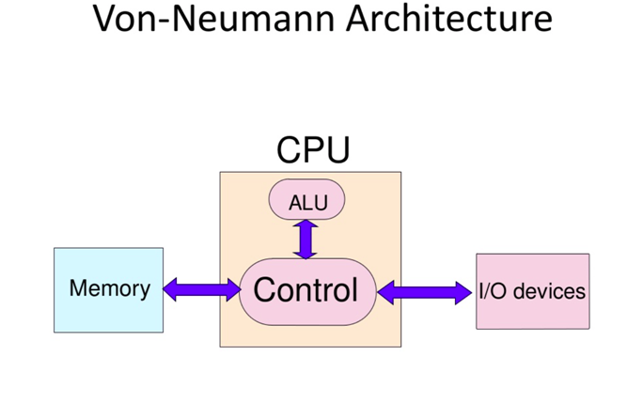

Slide 26
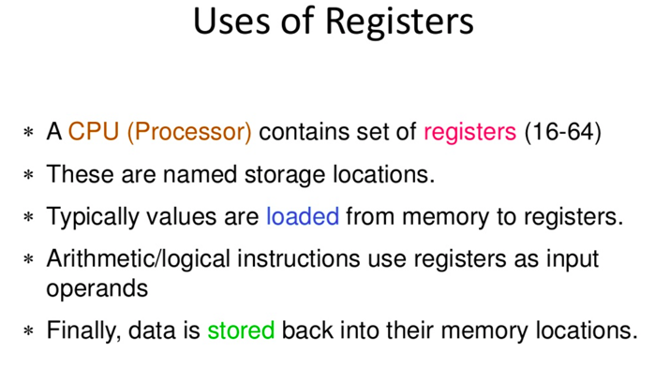

Slide 27
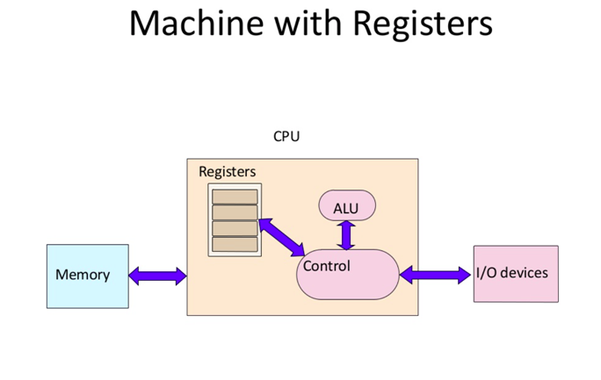

Slide 29
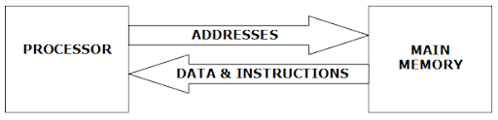
Processor Memory Interconnection

Slide 30
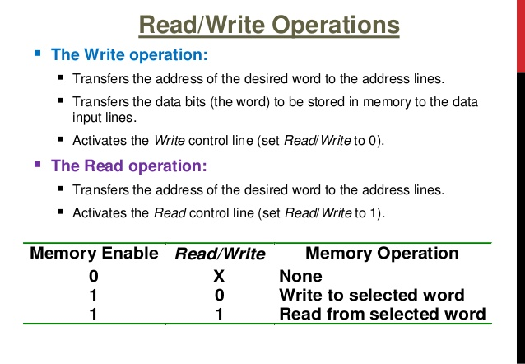

Slide 31
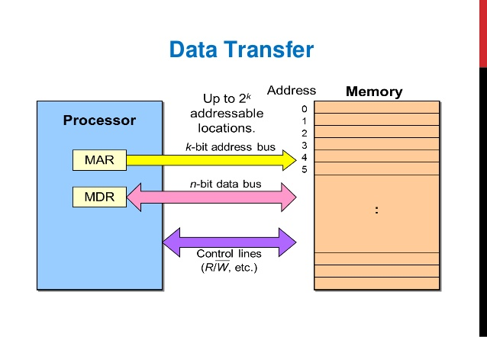

Slide 32
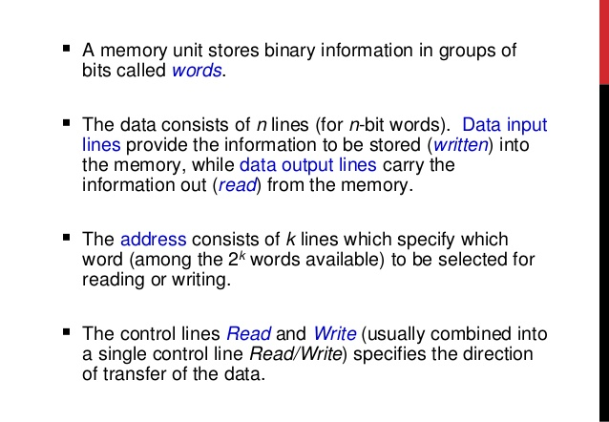

Slide 33
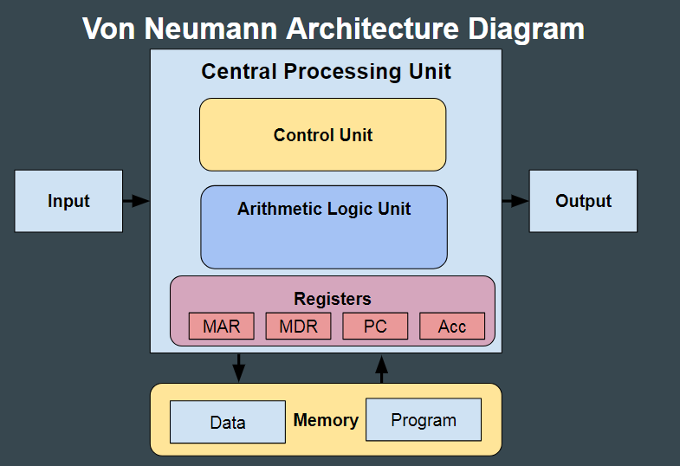

Slide 34
MAR | Memory Address Register | Holds the memory location of data that needs to be accessed
MDR | Memory Data Register | Holds data that is being transferred to or from memory
AC | Accumulator | Where intermediate arithmetic and logic results are stored
PC | Program Counter | Contains the address of the next instruction to be executed
IR | Instruction Register | Contains the current instruction during processing

Slide 35
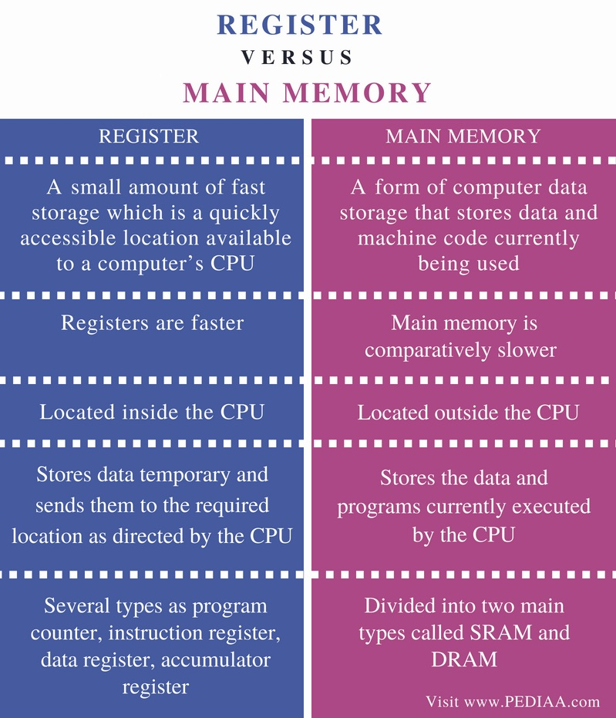

Slide 36
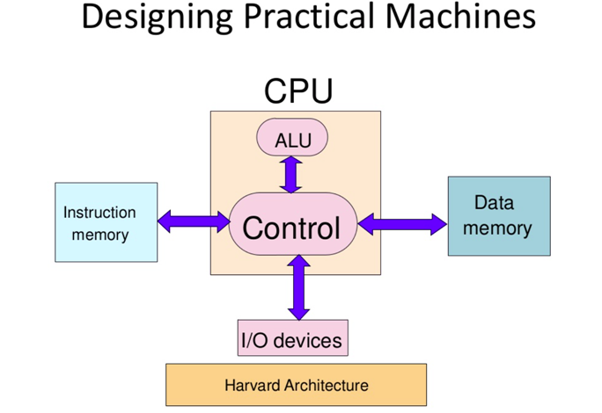

Slide 37
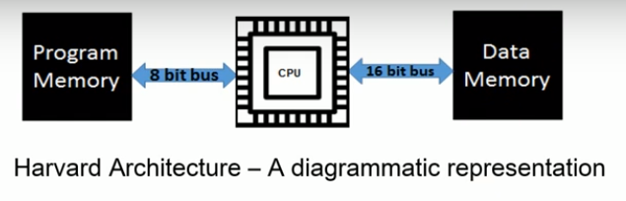
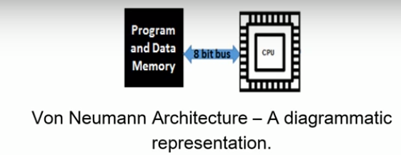
Harvard and Von-neumann Architecture

Slide 38
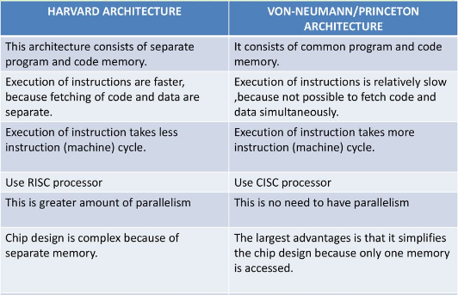
Harvard and Von-neumann Architecture

Slide 41
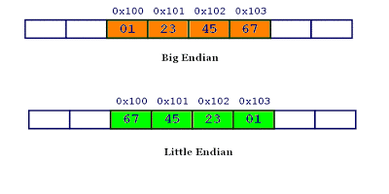
Little Endian and Big Endian

Slide 42
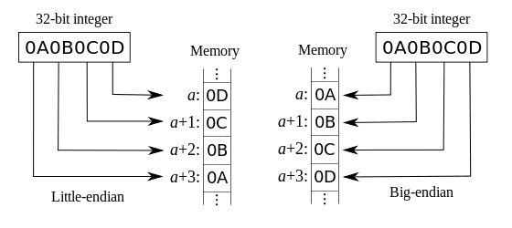

Slide 43
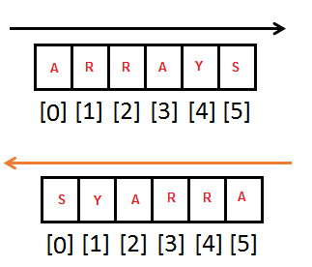
S.NO | Little Endian | Big Endian
1 | MS Paint | JPEG
2 | RTF | Adobe Photoshop
3 | BMP | Mac Paint

Slide 44
QUESTIONS!?!

